Slide 1
Microprocessor Architecture
It is an 8 bit processor avaliable in 40 pin IC pakage and uses +5v for power.
It can run at maximum frequency of 3MHZ
It is data bus with 8 bit width and address bus 16 bit thus it can address 2^16=64Kb of memory.

Slide 2
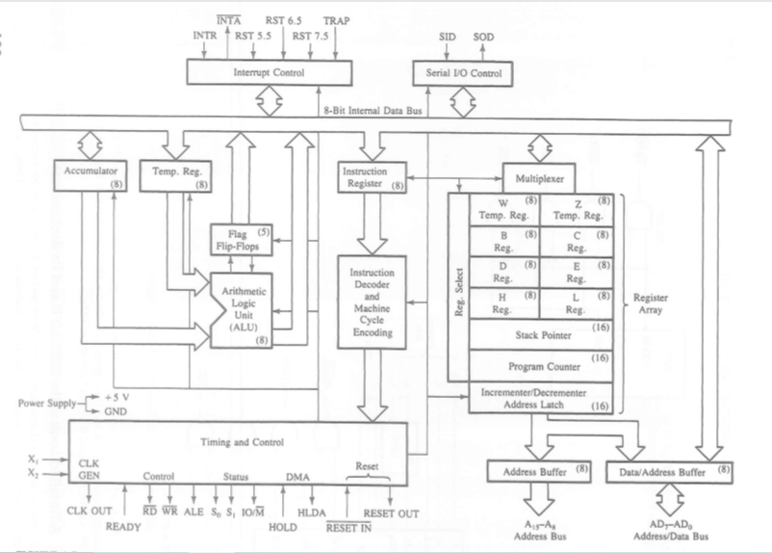
Internal architecture of 8085

Slide 3
Arithmetic and Logic Unit
ALU performs the arithmetic and logical operation such as ADD,SUB,AND ,OR etc
It uses data from memory and from Accumulator to perform operation.
The result of ALU are stored in accumulator.

Slide 4
Registers
Includes six register ,one accumulator and one flag register.
In addition it has two 16 bit register,stack pointer and program counter
8085 has six general purpose register to store 8 bit data they are B,C,D,E,H,L . They can be combined as register BC,DE & HL to perform some 16 bit operation.

Slide 5
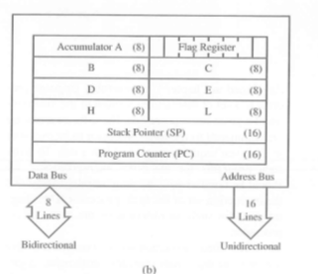
8085 programmable register

Slide 6
Accumulator
This register is used to store 8-bit data and to perform arithmetic and logical Operation.
Result is stored in Accumulator.
It is identified as A

Slide 7
Flag register
ALU includes five flip flop which are Set or reset after an operation according to the data condition of result in accumulator an other register.
Used to check the status of result
They are called zero(Z),carry(C),sign(S),parity(P),and Auxiliary carry(AC)flags.

Slide 8
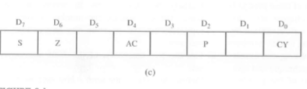
8085 flag register

Slide 9
Flag Status
Sign flag(S):s=1 if MSB of ALU result is 1.
Zero flag(Z);Z=1 if AlU result =00H
Parity flag(P):P=1 if ALU result in Even parity.
Carry flag(C):C=1 if carry/Borrow occurred in addition and substraction.
Auxilary Carry(AC):Carry from lower to upper nibble .Borrow from upper to lower nibble .

Slide 10
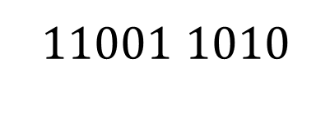
Examples
BC 1011 1100
DE 1101 1110
$$11001 1010$$
9AH

Slide 11
Program Counter
These are two 16-bit register use to hold memory address.
The size of these register is 16 bit because the memory address are 16 bit.
PC register is used to sequence the execution instruction
The function of PC is to point the memory address from which next byte is to be fetched.

Slide 12
Stack pointer
Is 16 bit register used as a memory pointer.
It points to a memory location in R/W memory called stack.

Slide 13
8085 addressing modes
Immediate addressing modes
Register addressing modes
Direct addressing modes
Indirect addressing modes
Implied addressing modes

Slide 14
Immediate addressing modes
In this mode the 8/16 bit data is specified in the instruction itself as one of its operand.
Eg MVI B,20H
20H is copied into register B

Slide 15
Register Addressing mode
Data is copied from one register to another.
MOV B,C
MOV B,C means data in register C is copied to register B.

Slide 16
Direct Addressing Modes
In this data is directly copied from given address to the register.
Eg LDA 5000H means data at address 5000H is copied to register/Accumulator A

Slide 17
Indirect Addressing mode
Data is transferred from one register to another by using the address pointed by the register.
Eg, MOV K,B means data is transferred from the memory address pointed by the register to the register K .

Slide 18
Implied Addressing mode
This mode doesn’t require any OPERAND ,the data is specified by OPCODE itself.
Eg, CMP

Slide 19
Instruction word size in 8085
The 8085 instruction set is classifies into 3 categories by considering the number of bytes occupied by instruction .
1 One byte instruction
2 Two byte instruction.
3 Three byte instruction

Slide 20
One byte instruction
Here the opcode and the operand of an instruction are represented in one byte only
Eg MOV C,A -4FH
ADD B 80H
CMA 2FH

Slide 21
Two byte instruction
In this type the 1st byte specifies the opcode and the 2nd byte specifies the operand.
Eg MVI A,4FH - 3EH, 4FH
ANI F0H –E6,F0H

Slide 22
Three byte instruction
Here the 1st byte (8 bits) indicate the opcode and the next two bytes specify the 16 bit address.
The lower order address(LSB) is represented in 2nd byte and the higher order address(MSB) in 3rd byte
Eg LDA C050H - 3A,50,C0
JMP 4100H- C3,00,40

Slide 23
Instruction cycle in 8085 microprocessor
Time required to execute and fetch an entire instruction is called instruction cycle. It consists:
Fetch cycle – The next instruction is fetched by the address stored in program counter (PC) and then stored in the instruction register.
Decode instruction – Decoder interprets the encoded instruction from instruction register

Slide 24
Instruction cycle in 8085 microprocessor
Reading effective address – The address given in instruction is read from main memory and required data is fetched. The effective address depends on direct addressing mode or indirect addressing mode.
Execution cycle – consists memory read (MR), memory write (MW), input output read (IOR) and input output write (IOW)

Slide 25
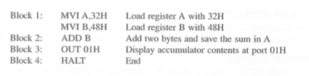
Execute a simple program

Slide 26
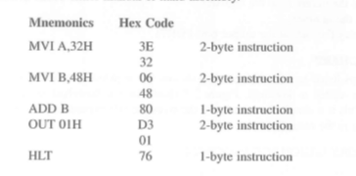

Slide 27
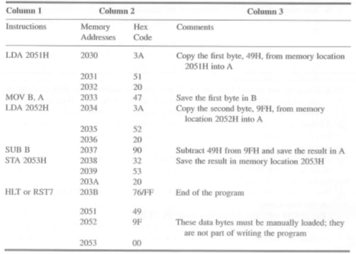
Substraction

Slide 28
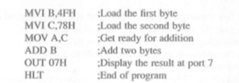
Addition

